Slide 1
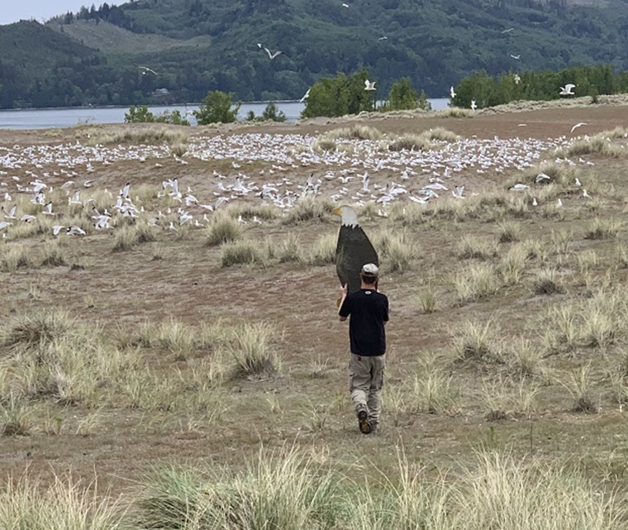
Estuary Avian
ESI - Rice Island

Slide 2
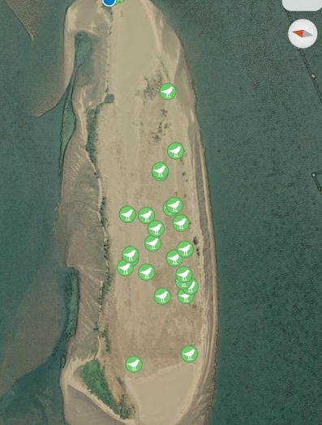
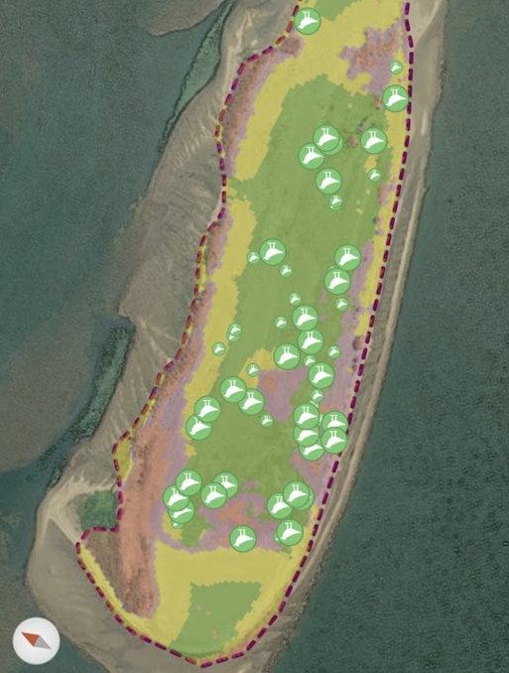
2012 Nav BiOp –
SHLA Impact?
Coordination with USFW:
    USF&W could not allow:
    - Pyro/cannons (SHLA impact)
    - Increased CATE egg take
    RBGU egg take
    Laser use mainland
SHLA Distribution May 24
SHLA Distribution June 8

Slide 3
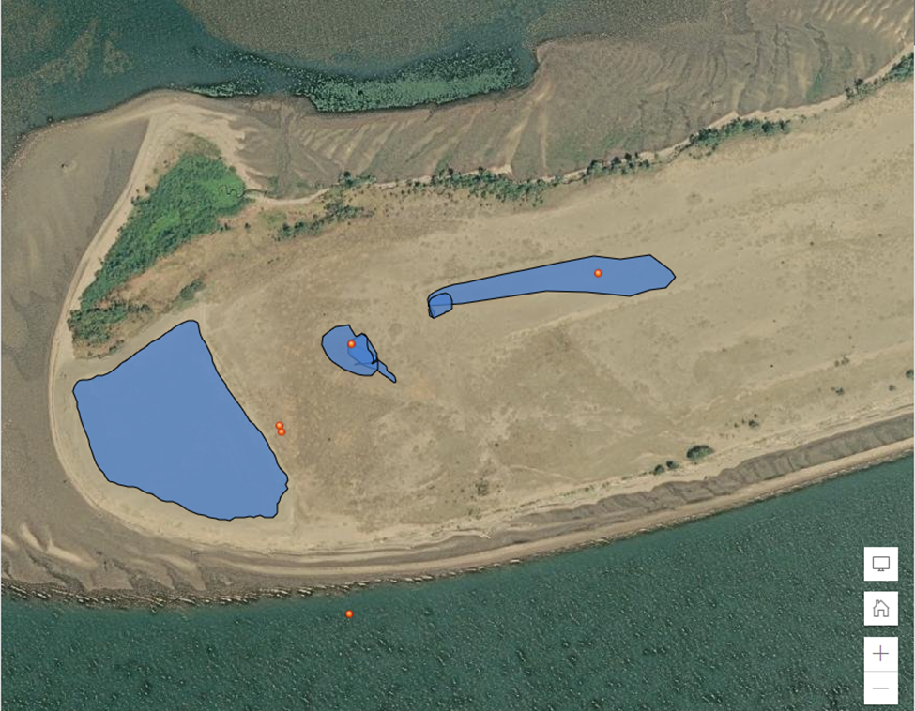
Plan for Enhanced CATE Dissuasion
USF&W could allow:
ATV’s on mainland (designated trails)
Day & night hazing to stop roosting
Handheld laser on beach and bowl
Mechanized laser in western bowl
250 Authorized CATE Egg take

Slide 4
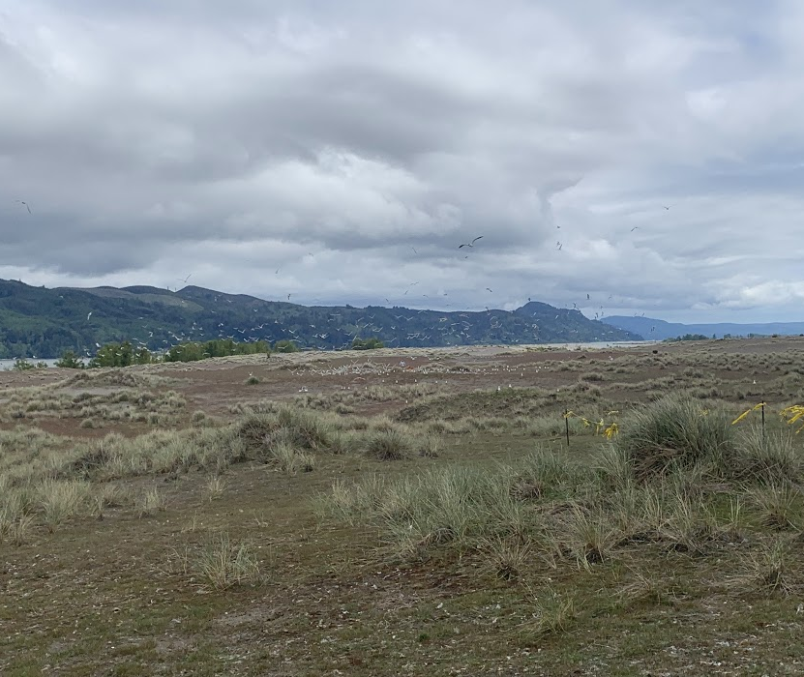
Eastern Incipient Colony
May 24

Slide 5
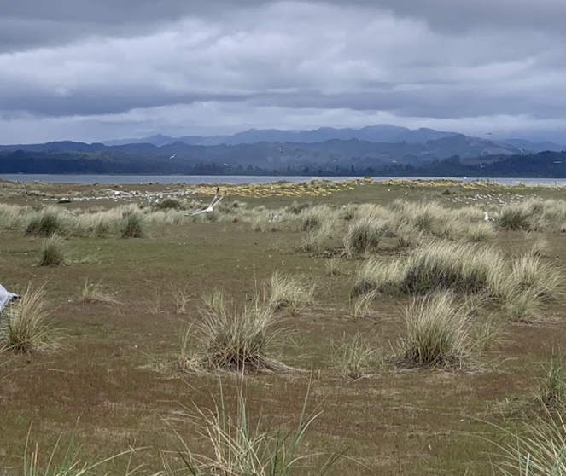
Western Incipient Colony
May 24

Slide 6
Enhanced dissuasion implemented on 5/25 – stopped CATE daytime activity and has diminished nocturnal roosting.

Slide 7
ESI = May 8
859 CATE

Slide 8
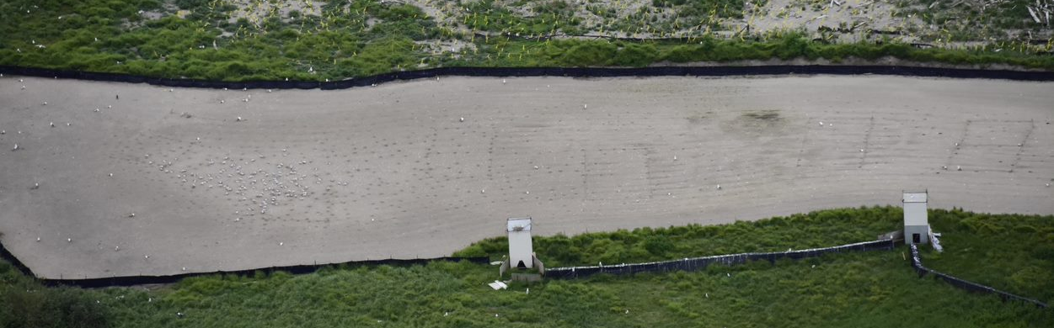
ESI - June 7
CATE = 130

Slide 10
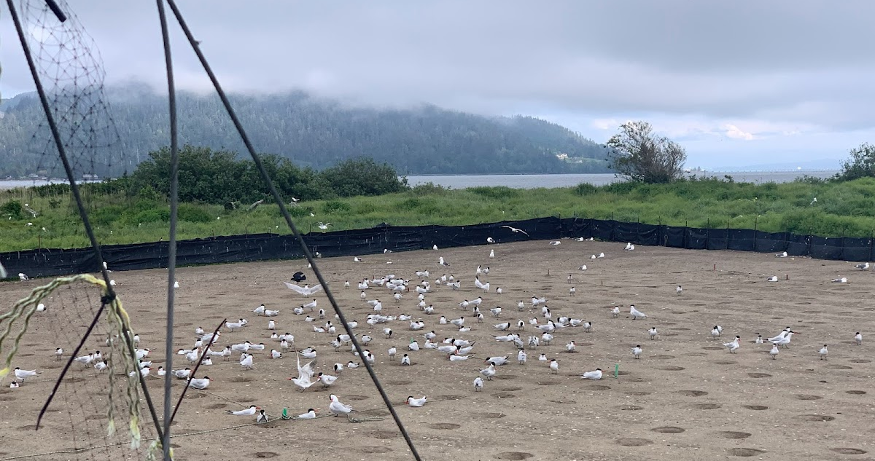

Slide 11
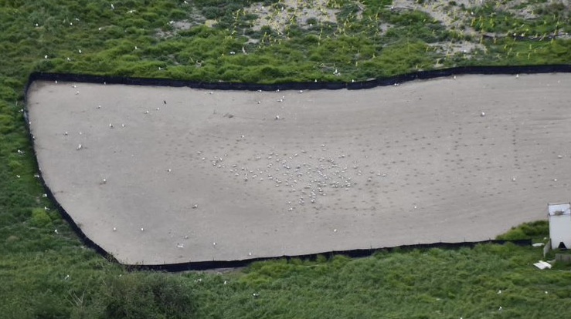

Slide 12
2012 & 2014 C&H BiOp
…This activity is a requirement in the National Marine Fisheries Service’s 2012 Biological Opinion to the Corps (Term and Condition 1(k)) specifying that if piscivorous birds are identified in the action area, hazing actions must be implemented to intentionally flush birds and discourage nesting on upland placement sites.
…These activities will entail human presence and passive dissuasion measures, including the use of physical barriers (nets and fencing, flagging, etc.)….
…In addition, if nesting activity is observed on placement sites, the Corps must actively discourage these behaviors, including destruction of nests….
…Terns have not attempted to nest in the areas used by larks on Rice, Miller Sands or Pillar Rock Islands so far. However, if tern dissuasion is necessary in suitable lark nesting habitat in the future, there may be direct and indirect effects to streaked horned larks and their nesting habitat…

Slide 13
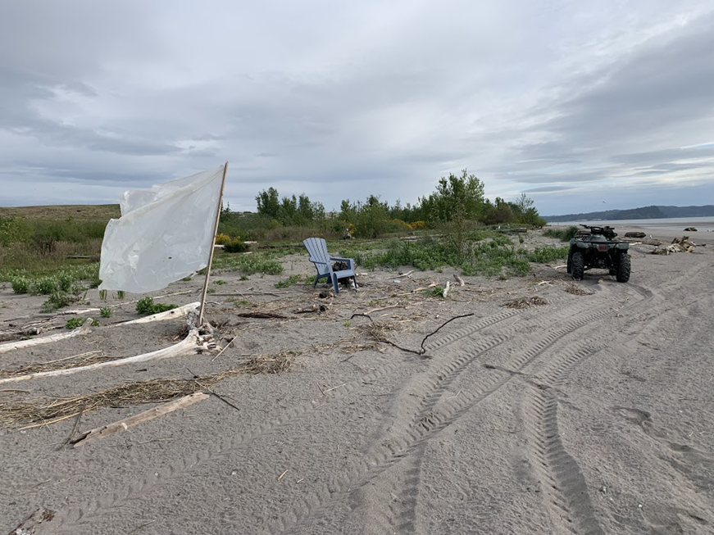
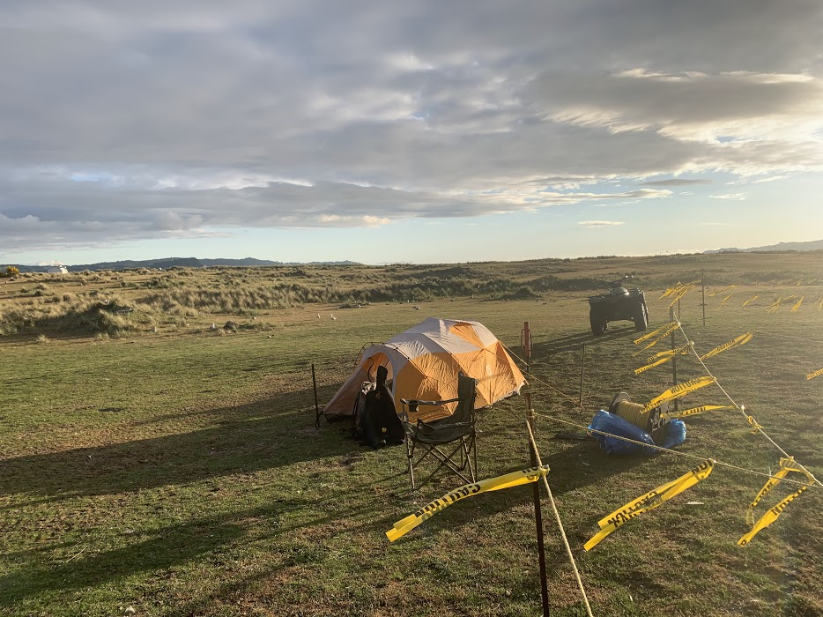
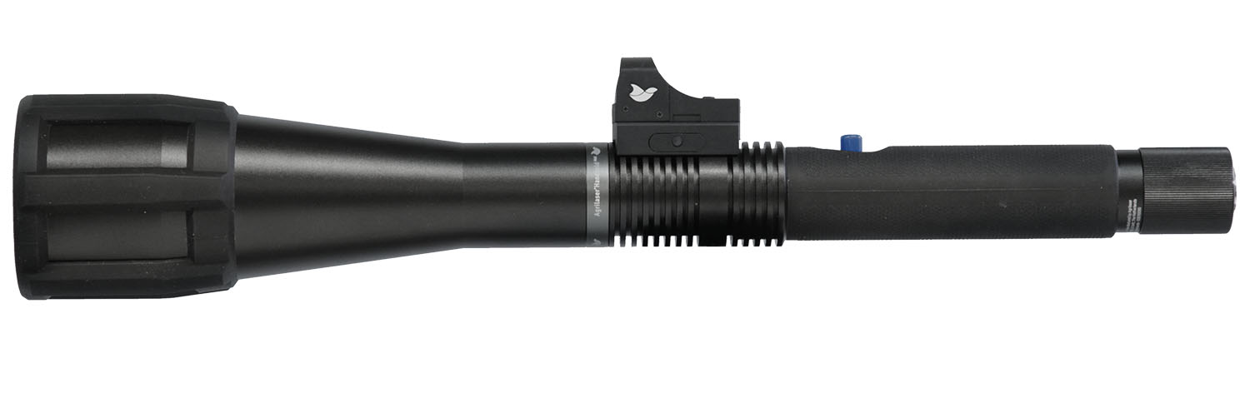

Slide 14
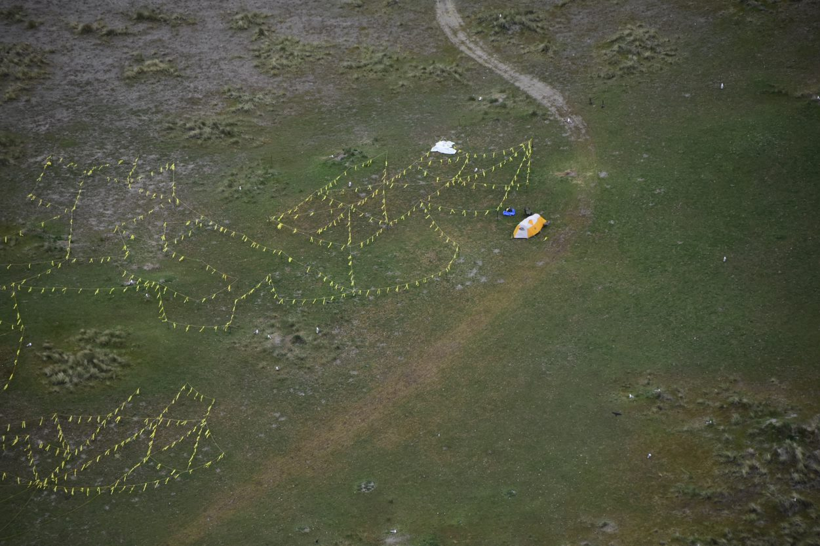

Slide 15
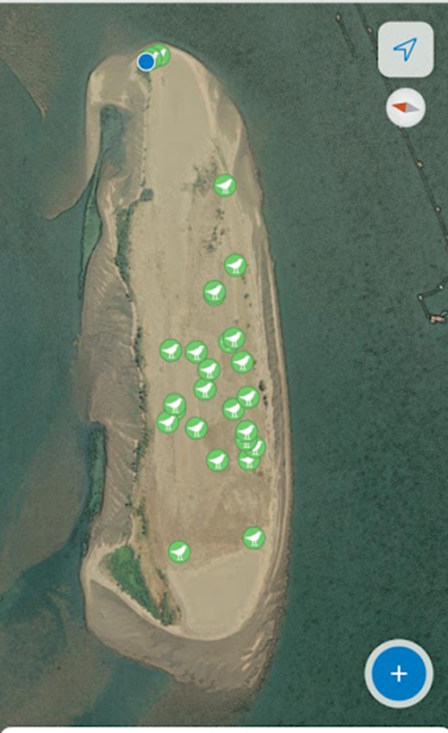

Streaked Horned Lark Impact?
2014 BiOp
“……This activity is a requirement in the National Marine Fisheries Service’s 2012 Biological Opinion to the Corps (Term and Condition 1(k)) specifying that if piscivorous birds are identified in the action area, hazing actions must be implemented to intentionally flush birds and discourage nesting on upland placement sites…”
Coordination with USFW:
  - SHLA displacement ~ CATE Colony
    - USF&W could not allow:
    Pyro/cannons (SHLA impact)
    Increased CATE egg take
    RBGU egg take
    -

